Slide 1
SPONSORSHIP OPPORTUNITIES
RACE START DATE: 12TH DECEMBER 2024

Slide 2
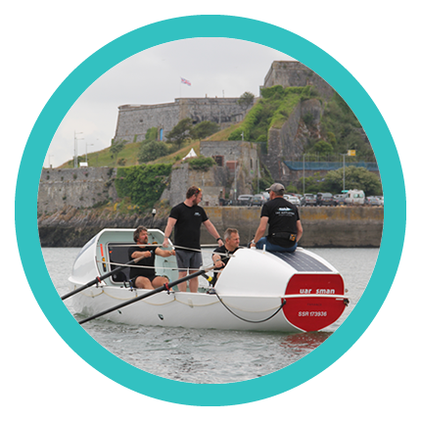
WHY PARTNER WITH US
GLOBAL PR AND SOCIAL MEDIA COVERAGE
OPPORTUNITY FOR STAFF OR FAMILY TO BE INVOLVED IN THE PREPARATION, TRAINING AND BUILD UP
ALL FUNDS RAISED GO DIRECTLY TO THE NOMINATED CHARITIES
Mayflower Atlantic Challenge – Sponsorship Brochure

Slide 3
WHO
ARE WE
All Plymouth born and raised (hence The Mayflower)
Two crew members with direct personal interest in the charities
Combined crew weight: 400kg
All funding their own race costs
Dan Wooler, 55
Founder
star* scheme
Dan Lewis, 45
Former
Royal Marine
Glynne Dunn, 56
Mayflower Captain, former Commando
Paul Adams, 56
Supporter
Mustard Tree
Mayflower Atlantic Challenge – Sponsorship Brochure

Slide 4
THE CHALLENGE
1 Ocean : 2 Charities : 4 Rowers : 3,000 Miles
Preparation:
shore-based weights/Concept 2 rowing exercises
outings on the Rannoch 45 ocean rowing boat, the Mayflower
courses in ocean safety & navigation, ocean rowing and survival
extensive medicals and kit inspections
Race start: La Gomera, Canary Islands – 12th December 2024
Race finish: English Harbour, Antigua
Duration: 40-45 days
Schedule: 2 hours on, 2 hours off….
for 40 days
Mayflower Atlantic Challenge – Sponsorship Brochure

Slide 5
SPONSORSHIP PACKAGES
DOLPHIN
MARLIN
£5,000 and up
£10,000 and up
Introductory talk at your workplace
Exclusive weekly media updates
Boat/website/kit branding (S)
Introductory talk at your workplace
Exclusive weekly media updates
Boat/website/kit branding (M)
Branded crossing memorabilia
Post-race talk at your workplace
Mayflower Atlantic Challenge – Sponsorship Brochure

Slide 6
SPONSORSHIP PACKAGES
ORCA
ORCA PLUS
£20,000 and up
£30,000 and up
Introductory talk at your workplace
In-office rowing event
Outing on The Mayflower
Exclusive weekly media updates
Boat/website/kit branding (L)
Branded crossing memorabilia
Post-race talk at your workplace
Boat naming rights (The XXX Mayflower)
Introductory talk at your workplace
In-office rowing event
Outing on The Mayflower
Exclusive weekly media updates
Boat/website/kit branding (XL)
Branded crossing memorabilia
Post-race talk at your workplace
Mayflower Atlantic Challenge – Sponsorship Brochure

Slide 7
LOGO POSITIONING
XL S S M S S M S S L
L S S M S S M S S XL
Mayflower Atlantic Challenge – Sponsorship Brochure

Slide 8
LOGO POSITIONING
We also have space on the underside of the boat….!
Mayflower Atlantic Challenge – Sponsorship Brochure

Slide 9
THANK YOU FOR YOUR SUPPORT
Dan Wooler
+44 (0) 7967 086 071
INFO@THEMAYFLOWER.CO.UK
WWW.THEMAYFLOWER.CO.UK

